Slide 1
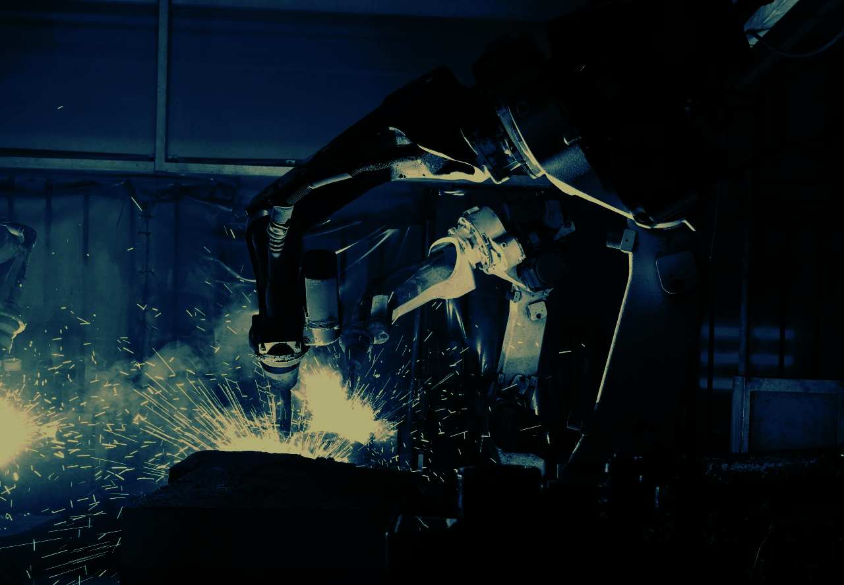


HACKATHON powered by
Build the Future of Industrial Intelligence
100% Monitoring, 0% Guesswork

Slide 2


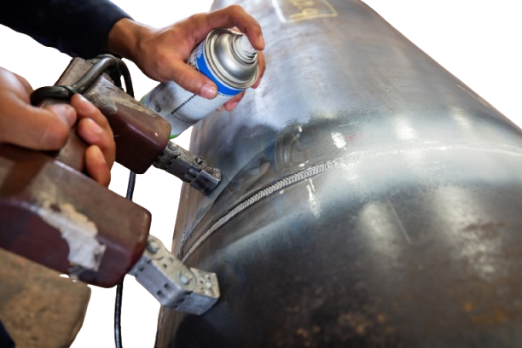
Problem
Every defective weld is a ticking time bomb
“In automotive, poor-quality defects can cost 10/40% of annual sales¹”
5 % — that’s all you inspect
2–3× — hidden defects cost in rework
0 % real-time QC — all checks are after the fact
1: True Cost Of Quality In The Automotive Industry | Intertek SAI Global Australia

Slide 3

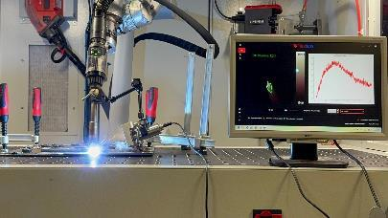
Therness Technology
Therness combines thermal imaging and AI-driven vision analysis to deliver real-time, 100 % weld inspection.
Integrated directly into production lines, it detects defects instantly, ensures digital traceability, and eliminates destructive testing.
Key Benefits
Real-time weld monitoring and analysis
Automatic defect detection and classification
Seamless integration with robotic welding systems
Complete digital quality documentation

Slide 4


Therness Technology
Therness technology seamlessly adapts to any welding setup, from traditional processes to advanced manufacturing, ensuring accurate, real-time monitoring in every environment.
Supported Materials:
Carbon steel
Stainless steel
Aluminum
Nickel-based alloys
Titanium alloys
Plastic materials
Supported Welding Methodologies
MIG / MAG Welding
TIG Welding
Submerged Arc Welding
Laser Welding
Wire Arc Additive Manufacturing
Cladding Applications
Notes:
6

Slide 5

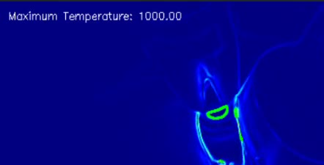

HeatCore AI
Key Features:
Proprietary deep-learning algorithms for weld-defect classification
Provides 99.2 % accuracy with < 100 ms response time
Edge-based architecture, seamless on-site deployment
Easy to integrate into any robotic cell; delivering reliable data with minimal setup and downtime
Key Specifications:
Weight: 270 g
Length: 7 cm
Frame Rate: 25 Hz
Air Purge System: Low-maintenance
Temperature Range: –20 °C to 1500 °C

Slide 6






Value Proposition
1
2
Cost Reduction & Sustainability
Process Optimization & Efficiency
Use real-time thermal data to optimize QC, automate processes, and integrate easily with minimal downtime
Cut QC costs up to 70% while reducing waste, energy use, and boosting ESG performance
4
3
Market Advantage & Business Value
Risk Mitigation & Compliance
Certified quality boosts reputation, supports premium pricing, and builds lasting customer trust
Achieve 100% real-time weld inspection with instant alerts and full traceability to prevent recalls and claims.

Slide 7
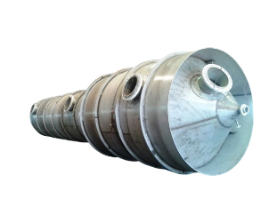
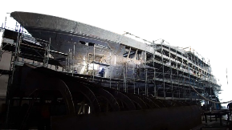




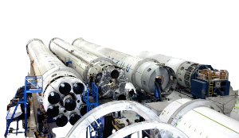
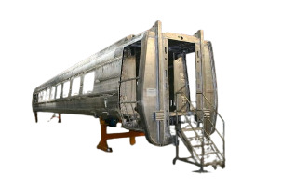


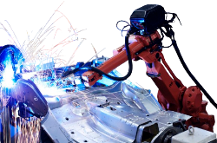
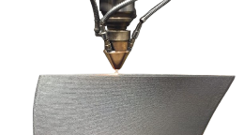
Industries we serve
Energy & Power Generation
Shipbuilding & Heavy Industry
3
4
2
5
Aerospace & Defense
Rail & Infrastructure
1
6
Additive Manufacturing & Advanced Fabrication
Automotive & Mobility
Notes:
17

Slide 8
Therness Hackathon
Welcome to the Challenge
What You’re About to Build
A reproducible dataset and split
A binary defect detector with calibrated confidence
A defect type classifier
An integrated evaluation pipeline
What Matters
Robust methodology
Confidence quality
Reproducibility
Measurable performance

Slide 9
Therness Hackathon
The Challenge + Deliverables
The Technical Assignment
What We Evaluate
Model Metrics
Binary F1 (defect positive)
Type Macro F1
Engineering Quality
Reproducibility
Clean structure
Inference pipeline
Presentation
Clear assumptions
Failure analysis
Confidence explanation
Phase 1: Data preparation + dashboard + reproducible split
Phase 2: Binary defect detection with confidence
Phase 3: Defect type classification
Final deliverable: Integrated pipeline + evaluation + demo

Slide 10
Therness Hackathon
Rules – Key Highlights
Submission & Evaluation
Final repository must be accessible and reproducible
Deliverables must be complete, functional, and documented
You must clearly explain methodology, assumptions, and confidence strategy
Fair Play
No plagiarism or reuse of external projects
Open-source tools allowed if license-compliant
Organizer reserves the right to disqualify rule violations

Slide 11
Therness Hackathon
Any Questions Before We Start?
If anything is unclear about:
The challenge
The deliverables
The timeline
The evaluation
Now is the moment to ask.

Slide 12
GOOD LUCK EVERYONE!
See you at the final pitch.
100% Monitoring, 0% Guesswork

